Slide 1
Chapter 15: Configure and manage Hyper-V

Slide 2
Learning Objectives – Configure and manage Hyper-V
Overview of Hyper-V
Overview of Hyper-V Manager
Best practices for configuring Hyper-V hosts
Hyper-V networking
Overview of nested virtualization
Enhanced Session Mode
GPU partitioning (GPU-P)
Hyper-V integration services
Learning recap
Notes:
In this Module, you learn the key features of the Hyper-V server role in Windows Server. You learn how to configure Hyper-V networking and are introduced to nested virtualization.
Note: This is a Module overview page which is meant to function as a Module organizer. The slide does not always list every unit in the equivalent Learn Module, instead highlights the main content areas in the Module, but the flow is the same. Recommended video demonstration are sometimes listed on this slide but are always included in the equivalent Learn Module. Students can also find those as individual units in the Learn content.

Slide 3
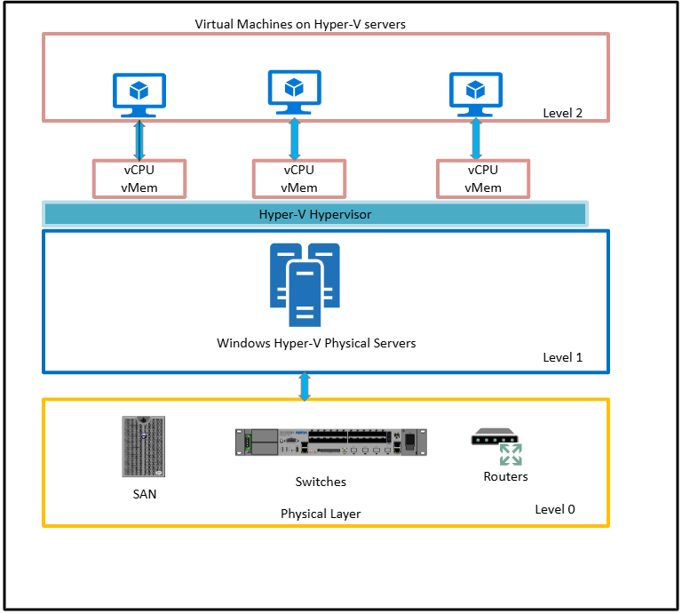
Define Hyper-V (1/2)
On-premises Hyper-V
Hardware virtualization layer
Native hypervisor that provides hardware virtualization capabilities
A role in Windows Server
Supports Windows 10 and 11 as an optional feature
Allows creation of multiple VMs on same hardware
Provides an isolated space for each VM to run its own operating system (OS)
Notes:
Learn – https://docs.microsoft.com/en-us/learn/modules/configure-manage-hyper-v/2-define-hyper-v
Hyper-V Technology Overview | Microsoft Docs
https://docs.microsoft.com/en-us/windows-server/virtualization/hyper-v/hyper-v-technology-overview

Slide 4
Define Hyper-V (2/2)
Supports many types of guest operating systems including:
CentOS, Red Hat Enterprise Linux, Debian, Oracle Linux, SUSE, and Ubuntu
Several Windows Server and Windows client OSs
FreeBSD
System requirements:
A 64-bit processor with second-level address translation (SLAT)
A processor with VM Monitor Mode extensions
Sufficient memory
Intel Virtualization Technology (Intel VT) or Advanced Micro Devices (AMD) Virtualization (AMD-V) enabled
Hardware-enforced Data Execution Prevention (DEP) enabled (Intel Execute Disable (XD) bit, AMD No Execute (NX) bit)
Installation Methods:
Server Manager
Install-WindowsFeature PowerShell cmdlet
Notes:
Learn – https://docs.microsoft.com/en-us/learn/modules/configure-manage-hyper-v/2-define-hyper-v
Supported Windows guest operating systems for Hyper-V on Windows, Windows Server, and Azure Local.
Windows Server
Windows Server 2025
Windows Server 2022
Windows Server 2019
Windows Server 2016
Windows Server 2012 R2
Windows Server 2012
Windows Server 2008 R2 with Service Pack 1 (SP1)
Windows Server 2008 with Service Pack 2 (SP2)
Windows Client
Windows 11
Windows 10

Slide 5
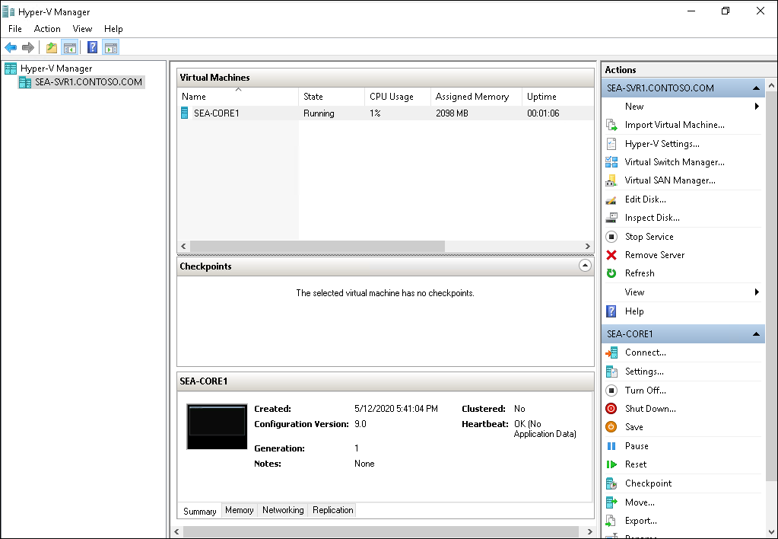
Define Hyper-V Manager
Hyper-V Manager:
graphical Interface to manage Hyper-V infrastructure
Supports:
Previous versions
Web Services (WS)-Management protocol
Alternate credential support
Other management tools include:
Windows PowerShell
PowerShell Direct
Windows Admin Center
SSH Direct (connect to Linux VMs)
Notes:
Learn – https://docs.microsoft.com/en-us/learn/modules/configure-manage-hyper-v/3-define-hyper-v-manager
Describe the Hyper-V Manager and the features that are used to connect to and manage virtual machines and switches. You may want to start the Hyper-V Manager on SEA-ADM1 to show an example as you discuss the console.
Also describe other methods for managing Hyper-V, including PowerShell, PowerShell Direct, Windows Admin Center, and SSH Direct.
Note: While this module focuses on using Hyper-V Manager to manage individual hosts and perform basic VM functions, it’s worth pointing out to students that there are some other options for managing larger scale environments.
Virtual Machine Manager (VMM): designed for managing large-scale virtual environments, including multiple hosts and clusters.
Windows Failover Cluster: provides high availability and disaster recovery capabilities for VMs.

Slide 6
Hyper-V best practices
Sufficient hardware to run virtual machines
Deploy VMs on separate disks or Clustered Shared Volumes
Avoid installing other server roles on the Host
Use Server Core to reduce the attack surface
Run the Best Practices Analyzer and resource metering
Manage Hyper-V with Remote Server Administrative Tools (RSAT)
Enable Enhanced Session Mode on the server (optional)
Notes:
Learn – https://docs.microsoft.com/en-us/learn/modules/configure-manage-hyper-v/4-configure-hyper-v-hosts-using-best-practices
Describe the best practices for configuring Hyper-V hosts and running virtual machines.
Note: Enhanced Session Mode is listed as optional as there are limitations on the ESM policy, including no support for non-Windows OS, Windows Hello, and resolution issues with low bandwidth.

Slide 7
Hyper-V networking
Hyper-V supports the following virtual network adapter types:
Legacy network adapter (Generation 1 only)
Synthetic network adapter (supports Generation 1 and Generation 2)
Hyper-V supports three types of virtual switches:
Virtual switch type | Description
External | Used to map a network to a specific network adapter or network adapter team. Provides external access outside of the host machine.
Internal | Used to communicate between the virtual machines on a host server and to communicate between the virtual machines and the host itself.
Private | Used to only communicate between virtual machines on a Hyper-V host.
Notes:
Learn – https://docs.microsoft.com/en-us/learn/modules/configure-manage-hyper-v/5-configure-hyper-v-networking
Provide an overview of Hyper-V networking by introducing virtual network adapters and virtual switches.
Explain that typically, you would select the standard Network Adapter; however, if you need the virtual machine to be able to boot to the network, then a Legacy Network Adapter is required.
Also explain that the External switch is used to configure direct access to an external network.
However, if a private network is routed through a router (such as a virtual machine configured as a router), it can also access external networks such as the Internet.

Slide 8
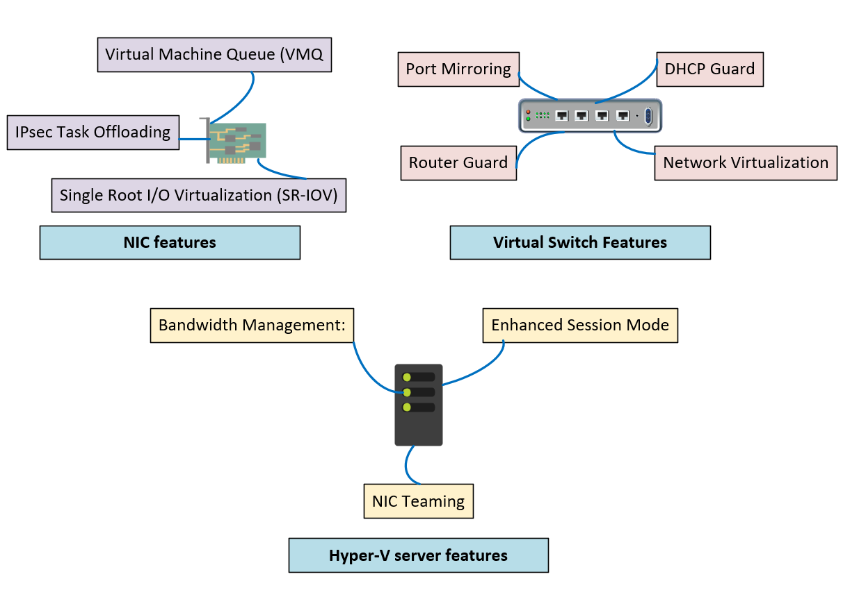
Hyper-V network features
Notes:
Learn – https://docs.microsoft.com/en-us/learn/modules/configure-manage-hyper-v/6-assess-advanced-hyper-v-networking-features
Don’t spend a lot of time on this slide but provide a brief overview of the features that support Hyper-V networking. Point out that some of these are Network Adapter settings, while others are switch configuration options. The Learn content covers these features in a little more detail and you can refer students to the link at the beginning of the instructor notes.
Hyper-V network virtualization – decouples virtual networks from physical infrastructure, removing VLAN and IP address constraints. This enhances agility and mobility in VM and tenant workload management. It can be implemented using components like Microsoft Network Controller, network virtualization gateways, and load balancers in Windows Server or System Center Virtual Machine Manager.
Bandwidth management – specify minimum and maximum bandwidth for a virtual network adapter. Hyper-V reserves minimum bandwidth even when other adapters on the same host are at capacity.
DHCP Guard – drops DHCP messages from VMs acting as rogue DHCP servers. This is useful when you don't control a VM's configuration, but it is hosted on a Hyper-V Server you manage.
Router Guard – drops router advertisement and redirection messages from VMs acting as unauthorized routers. This is useful when you don't control the configuration of VMs hosted on a Hyper-V Server you manage.
Port mirroring – copies incoming and outgoing packets from a network adapter to another VM configured for monitoring.
Network Interface Card (NIC) Teaming - also called load balancing and failover (LBFO).
It places multiple network adapters on a computer into a team for:
Aggregating bandwidth
Preventing connectivity loss by traffic failover in case of network component failure
Virtual Machine Queue (VMQ) – requires a host computer with a network adapter that supports the feature. Uses hardware packet filtering to deliver network traffic directly to a guest, improving performance by eliminating the need to copy packets from the host OS to the VM. Only network adapters specific to Hyper-V support VMQ
IP security (IPSec) task offloading – the guest OS and network adapter must explicitly support this feature. It allows a host's network adapter to perform calculation-intensive, security-association tasks. If hardware resources are insufficient, the guest OS handles these tasks. You can set the maximum number of offloaded security associations from 1 to 4,096. Only network adapters specific to Hyper-V support this feature.
Single-root I/O virtualization (SR-IOV) – to use SR-IOV, you must install specific hardware and special drivers on the guest OS. SR-IOV allows multiple VMs to share the same physical PCI Express hardware resources. If resources are insufficient, the virtual switch provides network connectivity. Only network adapters specific to Hyper-V support this feature.
In addition to the network features listed on the slide, the following additional Hyper-V networking features support Software-Defined Networking (SDN) infrastructures. Most of these features were introduced in Windows Server 2016 and later.
Switch Embedded Teaming (SET) – NIC Teaming option for Hyper-V networks that offers faster performance and better fault tolerance than traditional teams. Unlike traditional teams, SET allows the addition of multiple RDMA network adapters.
RDMA with Hyper-V – also known as Server Message Block (SMB) Direct, RDMA with Hyper-V requires hardware support in the network adapter. An RDMA-enabled network adapter functions at full speed with low resource utilization, resulting in higher throughput. This is crucial for busy servers with high-speed network adapters like 10 Gbps.
Note: RDMA services can use Hyper-V switches. This feature can be enabled with or without SET.
Virtual Machine Multi-Queue (VMMQ) – enhances VMQ by allocating multiple queues per VM and distributing traffic across these queues.
Note: d.VMMQ improves on VMMQ by dynamically allocating traffic to CPUs. As network throughput changes, Windows Server 2019 automatically adjusts the number of CPUs processing network packets, maximizing CPU efficiency in the Hyper-V host server and maintaining consistent network throughput for each VM. To use d.VMMQ, you must install a d.VMMQ-capable driver for your network adapters, but no additional setup is required for virtual workloads in Hyper-V
Converged network adapters – a converged network adapter allows a single network adapter or a team of network adapters to manage multiple types of traffic, including management, RDMA, and VM traffic. This reduces the need for specialized adapters for each host..
Network address translation (NAT) object – Windows Server includes a NAT object that translates internal network addresses to external addresses. This is useful for IP address management, especially when many VMs need internet access. Communication does not need to be initiated from the internet back to the internal VMs.
Tip: You can use the New-NetNat cmdlet to create a NAT object.

Slide 9
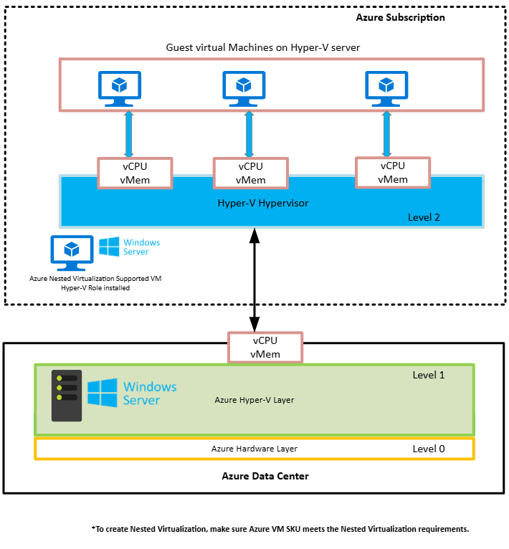
Hyper-V nested virtualization
Hyper-V feature you can use to install and run Hyper-V inside a guest VM
Enables a guest VM to be a Hyper-V host, able to then host other guest VMs
Useful for implementing virtual test and development environments
Notes:
Learn – https://docs.microsoft.com/en-us/learn/modules/configure-manage-hyper-v/7-define-nested-virtualization
Describe the Hyper-V nested virtualization feature – Hyper-V feature that you can use to install and run Hyper-V inside a guest VM. It's a virtualized environment running inside a virtualized environment. Nested virtualization enables a guest VM to be a Hyper-V host, which can then host other guest VMs. Nested virtualization can be extremely useful for implementing virtual test and development environments that would otherwise require physical hardware to run.

Slide 10
Enable nested virtualization
Requirements
Hyper-V Host and the Guest VM must be Windows Server 2016 or later
Enough Memory
VM configuration of 8.0 or greater
Intel processor with VT-x and EPT technology
AMD EPYC/Ryzen processor or later
Networking options
MAC address spoofing
NAT networking
# Configure nested virtualization
Set-VMProcessor -VMName “SEA-SVR1”
–ExposeVirtualizationExtensions $true
# Disable nested virtualization
Set-VMProcessor -VMName “SEA-SVR1”
–ExposeVirtualizationExtensions $false
Notes:
For more information, see: Run Hyper-V in a Virtual Machine with Nested Virtualization | Microsoft Learn
https://learn.microsoft.com/en-us/virtualization/hyper-v-on-windows/user-guide/enable-nested-virtualization
To configure nested virtualization:
Create a VM. See the prerequisites above for the required OS and VM versions.
While the VM is in the OFF state, run the command as shown on the slide on the physical Hyper-V host. This enables nested virtualization for the virtual machine.
Install Hyper-V within the virtual machine, just like you would for a physical server.
You can enable or disable nested virtualization with the help of the cmdlets given on the slide.
You may also want to mention that a second option for networking with nested virtual machines is to create a virtual NAT Network (using the New-NetNat command) on the physical host machine.
This option might be best where MAC address spoofing is not possible.
Note: For Windows Server 2022 or newer, and Windows 11 or later, the VM configuration version must be 9.3 or higher. Mention in addition that Windows 10 or later can also support nested virtualization.

Slide 11
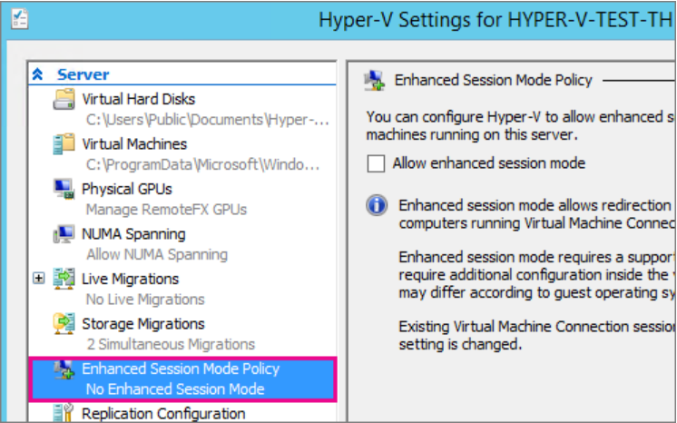
Enable Enhanced Session mode
Enhanced Session Mode enables local device redirection and dynamic display resizing
You connect through an RDP session
Connect to the computer hosting the virtual machine.
Select the host's computer name In Hyper-V Manager.
Select Hyper-V settings.
Under Server, select Enhanced Session Mode Policy.
Select the Allow enhanced session mode check box.
Under User, select Enhanced session mode.
Select the Allow enhanced session mode check box.
Click Ok.
Notes:
For more information, see: Use local resources on Hyper-V with VMConnect | Microsoft Learn
https://learn.microsoft.com/en-us/windows-server/virtualization/hyper-v/learn-more/use-local-resources-on-hyper-v-virtual-machine-with-vmconnect
Enhanced Session Mode enables you to move easily between the Hyper-V host and the guest using the virtual machine Connect window. When Enhanced Session Mode is enabled, the user can copy and paste text and files between the guest and host. Also, Enhanced Session Mode enables the user to change the resolution of the virtual machine to match a resolution suitable for the users display.
When you use enhanced session mode in the Virtual Machine Connection tool (VMConnect), you can connect to Hyper-V virtual machines (VMs) by using remote desktop protocol (RDP). Not only does this capability improve your general VM viewing experience, using RDP also provides a way for the VM and your computer to share devices. This functionality is only available for Windows VMs.
Using RDP in enhanced session mode offers many benefits:
Makes VMs resizable and high-DPI aware
Improves VM integration:
Shared clipboard
File sharing via dragging or copying and pasting
Makes device sharing possible:
Microphone and speakers
USB devices
Data disks, including drive C
Printers

Slide 12
GPU partitioning (GPU-P)
Share a GPU across multiple VMs
Create GPU partitions
Assign each partition to a VM that supports a set of users (multi-session)
Manage using PowerShell or WAC
Use cases for GPU-P
VDI applications
ML inference applications
Support for live migration and failover clustering
Each VM receives a portion of a GPU
VM
VM
Apps
Apps
GPU Driver
GPU Driver
½
½
Host 1
Host 2
Host GPU Driver
Host GPU Driver
Windows Server 2025 Cluster
Notes:
For more information, see: Partition and share GPUs with virtual machines on Hyper-V | Microsoft Learn
https://learn.microsoft.com/en-us/windows-server/virtualization/hyper-v/gpu-partitioning
GPU partitioning (GPU-P) uses a well-known technology called Single Root I/O Virtualization (SR-IOV) to partition a GPU in hardware.
GPU-P allows you to divide a physical GPU among different virtual machines and ensures predictable performance and secure isolation.
Windows Server 2025 now supports support high availability and live migration with GPU-P.
Workloads like virtual desktop infrastructure (VDI), AI, and ML inferencing need GPU acceleration. GPU partitioning can lower your infrastructure's total cost of ownership.
You can achieve this via DDA or GPU partitioning. GPU partitioning allows creating multiple partitions and assigning each to a VM hosting a VDI environment.
This helps achieve the desired density and scale the number of supported users significant.
Using GPUs, ML models can deliver quick results that can be acted on before data is sent to the cloud. The full data set can optionally be transferred to retrain and improve ML models. Along with DDA, where an entire physical GPU is assigned to a VM, GPU partitioning allows multiple inferencing applications to run in parallel on the same GPU, utilizing it to the maximum.

Slide 13
Overview of Hyper-V integration services
Integration services allow virtual machine to communicate with the Hyper-V host
Name | Description
Hyper-V Heartbeat Service | Reports that the VM is running correctly.
Hyper-V Guest Shutdown Service | Allows the host to trigger VMs shutdown.
Hyper-V Time Synchronization Service | Synchronizes the VM's clock with the host computer's clock.
Hyper-V Data Exchange Service (KVP) | Exchanges basic metadata between VM and host.
Hyper-V Volume Shadow Copy Requestor | Allows VSS Service to back up VM without shutting it down.
Hyper-V Guest Service Interface | Interface for host to copy files to/from VM.
Hyper-V PowerShell Direct Service | Manage VM with PowerShell without network connection.
Notes:
For more information, see: Hyper-V Integration Services | Microsoft Learn
https://learn.microsoft.com/en-us/virtualization/hyper-v-on-windows/reference/integration-services
Integration services (often called integration components), – services that allow the virtual machine to communicate with the Hyper-V host.’
These services differ in importance as some offer convenience while others have more of an impact on the virtual machine’s ability to function correctly.
Hyper-V Heartbeat Service
The heartbeat service tells Hyper-V that the operating system inside the virtual machine has booted. When disabled, the virtual machine can't report that the operating system inside of the virtual machine is operating correctly. This may impact some kinds of monitoring and host-side diagnostics.
Hyper-V Guest Shutdown Service
This Hyper-V integration service allows you to gracefully shut down a guest OS within a virtual machine directly from Hyper-V Manager. You don’t have to log into the virtual machine and manually initiate the OS shutdown. After starting the shutdown process, the guest VM will close any open applications, stop running services, and save the data to the disk. However, if this service is disabled, the host can’t trigger a friendly shutdown inside the virtual machine, causing potential data loss or data corruption.
Hyper-V Time Synchronization Service
This Hyper-V integration service synchronizes the virtual machine's system clock with the system clock of the host computer, which is vital when performing operations in a single virtual environment. Disabling this service would result in the virtual machine’s clock becoming inaccurate.
Hyper-V Data Exchange Service (KVP)
The data exchange service (sometimes called KVP) shares small amounts of machine information between virtual machine and the Hyper-V host using key-value pairs (KVP) through the Windows registry. Disabling data exchange may also impact some kinds of monitoring and host-side diagnostics.
Hyper-V Volume Shadow Copy Requestor
This Hyper-V integration service is required for Volume Shadow Copy Service (VSS), and allows (VSS) to back up applications and data on the virtual machine. VSS captures and copies images for backup on running systems, particularly servers, without unduly degrading the performance and stability of the services they provide. When disabled, the virtual machine can not be backed up while running (using VSS).
Hyper-V Guest Service Interface
This Hyper-V integration service enables copying files from a Hyper-V host to a running virtual machine and vice versa. With Hyper-V Guest Services, you no longer need a network connection for the guest and host machines to communicate. To copy files to and from the guest, run the Copy-VMFile cmdlet in PowerShell. Note that this feature is disabled by default.
Hyper-V PowerShell Direct Service
This Hyper-V integration service provides a mechanism to manage a virtual machine with PowerShell via a VM session without a virtual network.
PowerShell Direct allows PowerShell management inside a virtual machine from the Hyper-V host regardless of any network configuration or remote management settings on either the Hyper-V host or the virtual machine.

Slide 14
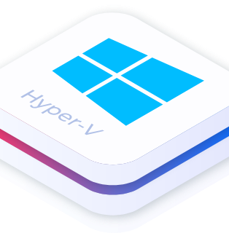
Configure and manage Hyper-V virtual machines

Slide 15
Learning Objectives – Configure and manage Hyper-V VMs
VM Settings and configuration
VM storage
Virtual hard disk formats and types
Manage VM states and checkpoints
Import and export VMs
Configure Discrete Device Assignment
Learning recap
Notes:
In this Module, you learn about virtual machine storage and how to manage the state of a virtual machine.
Note: This is a Module overview page which is meant to function as a Module organizer. The slide does not always list every Unit in the equivalent Learn Module, instead highlights the main content areas in the Module, but the flow is the same. Recommended video demonstration are sometimes listed on this slide but are always included in the equivalent Learn Module. Students can also find those as individual units in the Learn content.

Slide 16
VM configuration and Generation versions
VM configuration version identifies:
Compatibility of the VM components with the version of Hyper-V installed on the host machine
Windows Server 2025 host machines support configuration versions 8.0 through 12.0 or greater
To update a configuration version, use the following command:
Update-VMVersion <vmname>
Generation 1 VMs:
Support 32 and 64-bit operating systems
Only support boot volumes a maximum of 2 TB
Supports legacy BIOS
Generation 2 VMs:
Support only 64-bit operating systems
Support secure boot and shielded VMs
Support boot volumes a maximum of 64 TB
Supports Unified Extensible Firmware Interface (UEFI)
Notes:
Learn – https://docs.microsoft.com/en-us/learn/modules/configure-manage-hyper-v-virtual-machines/2-list-virtual-machine-configuration-versions
Learn – https://docs.microsoft.com/en-us/learn/modules/configure-manage-hyper-v-virtual-machines/3-list-virtual-machine-generation-versions
Describe the decisions required for choosing a virtual machine configuration version and generation version.
You should also state that generation 2 virtual machines do not use emulation for keyboard, mouse, and video, which also results in using fewer resources and reducing the attack surface from the guest operating system.

Slide 17
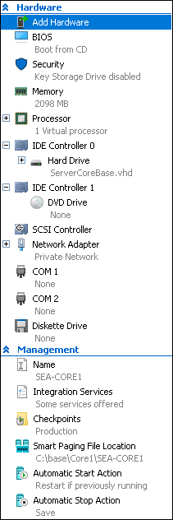
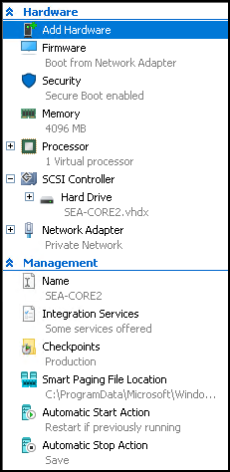
VM settings
Generation 1 settings
Generation 2 settings
VM settings are grouped into two main areas:
Hardware
Management
Available hardware components depend on the generation version of the VM
Generation 2
UEFI, Secure Boot, vTPM, and Enhanced Session Mode
Generation 1
Designed for legacy hardware configurations that use a traditional BIOS
Notes:
Describe the virtual machine settings. These are displayed in the Settings dialog box for a virtual machine in Hyper-V Manager.

Slide 18
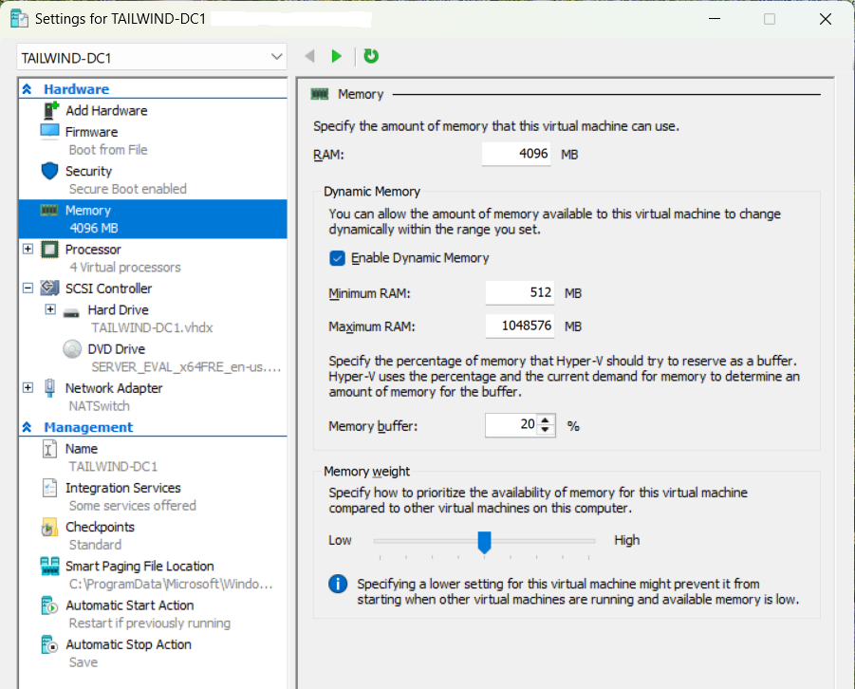
Configure Dynamic Memory for Hyper-V virtual machines
Enable dynamic memory
Minimum RAM is the amount of memory allocated at startup or upgrade
Minimum RAM value – at least 32 MB and cannot exceed the startup memory value
Maximum RAM value cannot be lower than startup memory.
Default setting for Maximum RAM = 1TB
Memory Buffer ensures VM has additional memory available to handle unexpected spikes in memory demand
Memory weight distributes memory among multiple VMs
Startup RAM
Notes:
For more information, see: Hyper-V Dynamic Memory Overview | Microsoft Learn
https://learn.microsoft.com/en-us/previous-versions/windows/it-pro/windows-server-2012-r2-and-2012/hh831766%28v=ws.11%29
With dynamic memory, the hypervisor can retrieve unused RAM from VMs, enabling a greater number of VMs to run on a single host. However, configuring dynamic memory presents some challenges and is not as straightforward as configuring static memory. It’s advisable to determine your memory requirements upfront as some configuration options might impact each other in ways that are not necessarily immediately obvious. This is particularly the case when enabling dynamic memory.
Note: Mention that some older applications may require a fixed amount of memory because they don’t support dynamic memory, for example older versions of SQL Server.
Choosing minimum and maximum RAM values
When configuring the minimum RAM value, make sure you don’t set it too low, as the operating system generally requires more RAM during startup or upgrade operations than during regular operations.
Alternatively, make sure you don’t set the minimum RAM value too high, putting a burden on the host’s physical memory. This may occur if several VMs boot simultaneously as for example, during an automatic startup, potentially causing VM initialization failures.
The maximum RAM value cannot be lower than the startup memory and is limited to 1 TB. The default setting is 1,048,576 MB (1 TB).
After the startup process completes, Hyper-V dynamically adjusts the memory allocated to the VM to its current needs, based on the parameters specified within the minimum and maximum RAM values.
Memory Buffer
When a VM that has dynamic memory enabled experiences a sudden surge in demand, the hypervisor needs to quickly increase the available RAM. But if an application is already constrained at the top level of its resource limits, this process may not happen quickly enough. This can cause performance to quickly deteriorate. Hyper-V addresses this by allocating a bit more memory to a VM than it requests. The extra memory provides a buffer and better allows the VM to handle sudden increases in memory demand.
Memory weight
Provides Hyper-V with a way to determine how to distribute memory among virtual machines if there is not enough physical memory available in the computer to give every virtual machine its requested amount of memory.
Recommendation: Use a monitoring tool to monitor your VMs and choose minimum and maximum values for RAM based on the monitoring results.

Slide 19
Hyper-V Storage considerations
Consider the following factors when planning storage for virtual hard disks
High-performance connection to storage
Redundant storage
High-performance storage
Adequate growth space
Supported storage types include
Fibre channel connections
Server Message Block (SMB) 3.0 file shares
Notes:
Learn – https://docs.microsoft.com/en-us/learn/modules/configure-manage-hyper-v-virtual-machines/6-determine-storage-options-for-vms
Provide an overview of storage options for Hyper-V. Focus this discussion on considerations for where to store the Hyper-V files. The next couple of topics will cover the details on the types and formats of Hyper-V files.

Slide 20
Virtual hard disk (1/2)
Virtual hard disk formats include
VHD
Up to 2040 GB in size
Typically used to support older Hyper-V versions
VHDX
Up to 64 TB in size
Recovery from corruption issues
Supports larger block size resulting in increased performance
Notes:
Learn – https://docs.microsoft.com/en-us/learn/modules/configure-manage-hyper-v-virtual-machines/4-list-available-vhd-formats-types
Provide an overview of the virtual hard disk (VHD) formats and types. Point out that .VHD files were used in previous versions of Windows Hyper-V. Windows Server 2012 introduced the .vhdx file format. You may also want to mention that when you create a new dynamically expanding disk, .vhd files start at approximately 260 kilobytes (KB). VHDX files start at approximately 4,096 KB. Also point out that if using differencing disks, care needs to take place for the parent disk. If the parent disk is modified, linked differencing disks may fail. Also, if you move the parent disk, you will need to relink the differencing disks to point to the new location.

Slide 21
Virtual hard disk (2/2)
Type of disc | Description
Fixed | Allocates all of the hard disk space immediately
Dynamic | The disk only uses the amount of space that needs to be allocated, and it grows as necessary
Differencing | Associated with another virtual hard disk in a parent-child configuration. Any changes made to the differencing disk does not affect the parent disk.
Pass through | Allows the virtual machine to connect directly to an Internet Small Computer Systems Interface (iSCSI) (logical unit number) LUN or a physical disk attached on the host machine
Notes:
Learn – https://docs.microsoft.com/en-us/learn/modules/configure-manage-hyper-v-virtual-machines/4-list-available-vhd-formats-types

Slide 22
Shared VHDX and VHD Set files
Virtual machine cluster node 1
Virtual machine cluster node 2
Shared VHDX or VHD Set (VHDS)
Notes:
Learn – https://docs.microsoft.com/en-us/learn/modules/configure-manage-hyper-v-virtual-machines/7-define-shared-vhds-vhd-sets
Point out that sharing a virtual disk is typically used in failover clustering scenarios. Using a VHD Set is the
recommended method over the legacy Shared VHDX method when using the latest versions of Windows Server.

Slide 23
Manage VM states and checkpoints
A VM can be in one of the following states:
Checkpoints:
Off
Starting
Running
Paused
Saved
Allows you to take a snapshot of a virtual machine at a specific point in time
Two types of checkpoints
Production checkpoints
Standard checkpoints
Maximum of 50 checkpoints per virtual machine allowed
Notes:
As you describe the use of checkpoints, stress that these are not a replacement for backups. Checkpoints used to be called snapshots in previous Windows versions. You may want to explain and show how to disable checkpoints for a specific VM by opening the Settings box of a VM. The option is located on the Checkpoints page.
Starting with Windows Server 2016 and Windows 10, you can choose between standard and production checkpoints for each virtual machine. Production checkpoints are the default for new virtual machines.
Production checkpoints are "point in time" images of a virtual machine, which can be restored later on in a way that is completely supported for all production workloads. This is achieved by using backup technology inside the guest to create the checkpoint, instead of using saved state technology.
Standard checkpoints capture the state, data, and hardware configuration of a running virtual machine and are intended for use in development and test scenarios. Standard checkpoints can be useful if you need to recreate a specific state or condition of a running virtual machine so that you can troubleshoot a problem.
For more information, see: Choose between standard or production checkpoints in Hyper-V | Microsoft Learn
https://learn.microsoft.com/en-us/windows-server/virtualization/hyper-v/manage/choose-between-standard-or-production-checkpoints-in-hyper-v

Slide 24
Import and export VMs
When importing a VM you have three options:
Register the virtual machine in-place (use the existing unique ID)
Restore the virtual machine (use the existing unique ID)
Copy the virtual machine (create a new unique ID)
Export options:
Export a specific checkpoint
Export a virtual machine with all checkpoints
Notes:
Describe options for importing and exporting VMs.

Slide 25

Securing virtualization in Windows Server

Slide 26
Learning Objectives – Securing virtualization in Windows Server
Guarded fabric
Attestation modes for guarded fabric
Host Guardian Service
Types of protected VMs in a guarded fabric
General process for creating shielded VMs
Process for powering on shielded VMs
Learning recap
Notes:
In this Module, you learn how to secure the Hyper-V host and associated virtual machines using security features within a guarded fabric provided by Windows Server.
Note: This is a Module overview page which is meant to function as a Module organizer. The slide does not always list every Unit in the equivalent Learn Module, instead highlights the main content areas in the Module, but the flow is the same. Recommended video demonstration are sometimes listed on this slide but are always included in the equivalent Learn Module. Students can also find those as individual units in the Learn content.

Slide 27
Guarded fabric (1/2)
A security solution used to protect virtual machines against:
Inspection
Theft
Tampering from either malware or malicious intent
Security benefits of a guarded fabric include:
Secure and authorized Hyper-V hosts
Verification that a host is in a heathy state
Providing a secure method to release keys to healthy hosts
Notes:
Learn - https://docs.microsoft.com/en-us/learn/modules/secure-hyper-v-workloads/2-define-guarded-fabric
Provide an overview of the concept of a guarded fabric. Use the diagram on the PowerPoint slide to visually represent each of the components that you introduce.

Slide 28
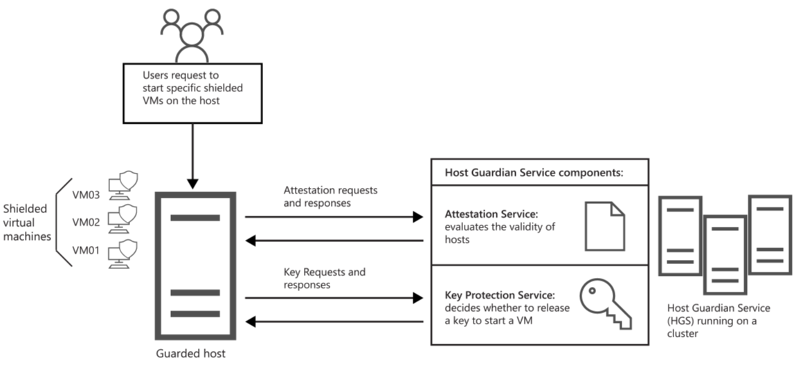
Guarded fabric (2/2)
Notes:
Learn - https://docs.microsoft.com/en-us/learn/modules/secure-hyper-v-workloads/2-define-guarded-fabric
Introduce each of the components
Guarded Hyper-V hosts
Host Guardian Service
Shielded or encryption-supported virtual machines
Also include tools used to automate and manage a guarded fabric.
System Center Virtual Machine Manager (VMM)
PowerShell

Slide 29
Attestation modes for guarded fabric
Guarded fabric attestation is the process of evaluating and validating the Hyper-V host
Attestation mode | Description
Trusted Platform Module (TPM)-trusted attestation | Hardware-based attestation method offering the strongest protection but does require a more complex configuration and higher host hardware requirements Requirements include TPM 2.0 and UEFI 2.3.1 with Secure Boot enabled A guarded Hyper-V host is approved and validated based upon its TPM identity, Measured Boot sequence, and code integrity policies
Host key attestation | Based upon asymmetric key pairs Used when existing Hyper-V host machines do not support TPM 2.0 A guarded Hyper-V host is approved and validated based upon possession of the key
Notes:
Learn – https://docs.microsoft.com/en-us/learn/modules/secure-hyper-v-workloads/3-define-host-guardian-service
Describe the attestation modes used to validate a Hyper-V host in a guarded fabric infrastructure.

Slide 30
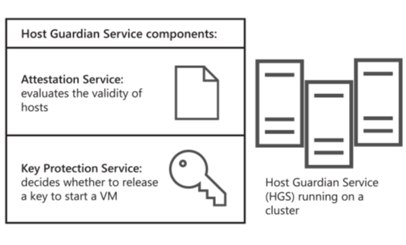
Host Guardian Service
Host Guardian Service includes:
Attestation service
Key Protection Service (KPS)
Helps to ensure:
Protected VMs contain BitLocker encrypted disks
Shielded VMs are deployed from trusted template disks and images
Passwords and other secrets are protected when a shielded VM is created
Control of where the shielded VM can be started
Notes:
Learn – https://docs.microsoft.com/en-us/learn/modules/secure-hyper-v-workloads/3-define-host-guardian-service
Provide a high-level overview of what the Host Guardian Service is and considerations for implementing it.

Slide 31
Types of protected VMs in a guarded fabric
Capability | Encryption-supported | Shielded
Secure boot | Yes, required but configurable | Yes, required and enforced
Virtual TPM | Yes, required but configurable | Yes, required and enforced
Encrypt VM state and live migration traffic | Yes, required but configurable | Yes, required and enforced
Integration components | Configurable by fabric admin | Certain components blocked such as PowerShell Direct (enabled in Windows Server v1803), and data exchange
Notes:
This is slide 1
https://docs.microsoft.com/en-us/windows-server/security/guarded-fabric-shielded-vm/guarded-fabric-and-shielded-vms#what-are-the-types-of-virtual-machines-that-a-guarded-fabric-can-run
Describe the differences between encryption-supported and shielded VMs. Point out that both are considered secure; however, encryption-supported VMs allow more flexibility for trusted fabric administrator configuration changes.
A guarded fabric is capable of running:
Shielded VMs
Encryption-supported VMs
Normal VMs

Slide 32
Types of protected VMs in a guarded fabric (cont.)
Capability | Encryption-supported | Shielded
Virtual machine connection, HID devices (keyboard, mouse) | On, cannot be disabled | Enabled for hosts starting at Windows Server v1803; Disabled on earlier hosts
COM/Serial ports | Supported | Disabled (cannot be enabled)
Attach a debugger to the VM process | Supported | Disabled (cannot be enabled)
Notes:
This is slide 2

Slide 33
General process for creating shielded VMs
Create a shielded VM template disk
Create a shielded data file
Deploy a shielded VM
Also called a provisioning data file (PKD)
Shielding Data File Wizard
Deploy using:
System Center Virtual Machine Manager (SCVMM)
PowerShell
VHDX disk type
Globally Unique Identifiers (GUID) partition table
2 partitions
NTFS file system
BitLocker encrypted
Shielded Template Disk Creation Wizard
Notes:
Learn – https://docs.microsoft.com/en-us/learn/modules/secure-hyper-v-workloads/8-implement-shielded-vm
Provide a high-level overview of how to create a shielded virtual machine. Note that this is a general process, and students should refer to the Microsoft Docs site for more detailed information. There is no need to go into a lot of detail at this point.
Note: When creating the shielded VM signed template disk for the shielded VM, you must first prepare the OS disk on which to install the OS. The disk must be a .vhdx file format. In addition to the requirements listed on the slide, the supported OS must be generalized and be able to be support generation 2 VMs and the Microsoft Secure Boot process. The generalized disk must be prepared and encrypted with BitLocker. You can perform this task by using the Shielded Template Disk Creation Wizard.

Slide 34
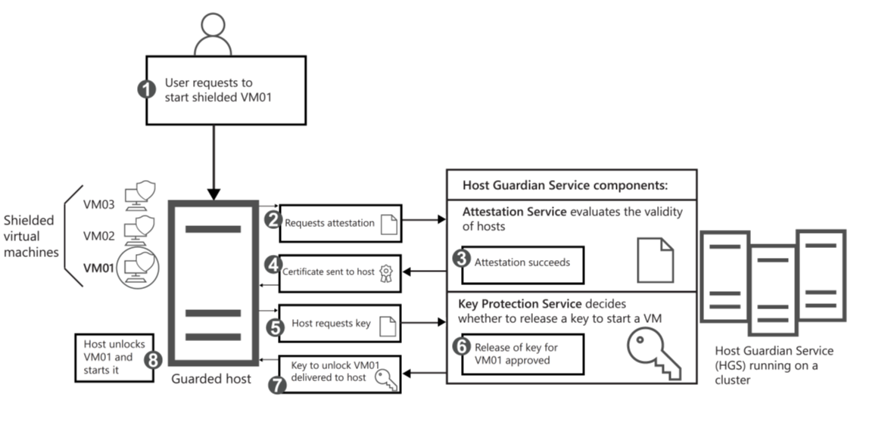
Process for powering on shielded VMs
Notes:
Explain that the illustration represents the Process for powering-on shielded virtual machines. Elaborate on the process.
User requests to start a shielded VM
Attestation requested
Attestation succeeds or fails The attestation mode determines which checks are needed to successfully attest the host is healthy.
Attestation certificate sent to host If attestation is successful, a health certificate is sent to the host
Host requests VM key. Guarded hosts need to request the necessary keys from the KPS on the HGS.
Key is released The KPS examines the health certificate provided by the guarded host to determine its validity.
Key is returned to host If the health certificate is valid, the KPS attempts to decrypt the provided secret from the guarded host vides powers on shielded VM The guarded host can now unlock and power-on the shielded VM.

Slide 35
Hyper-V Live Migration

Slide 36
Overview of Hyper-V Live Migration
Move running virtual machines between Hyper-V hosts with virtually no perceived downtime
Network connections stay active and user sessions remain open throughout the transition
Introduced in Windows Server 2008 R2; expanded in 2012 to work without Failover Clustering
Enables planned maintenance, hardware refresh, and load balancing during business hours
Pairs with Failover Clustering to deliver highly available and fault-tolerant systems
Supported on Windows Server 2016, 2019, 2022, 2025, and Azure Local

Slide 37
Types of Hyper-V Live Migration
Live Migration (shared storage): VM moves between cluster nodes; storage stays on shared SMB, iSCSI, or CSV
Shared Nothing Live Migration: VM and its storage move together between standalone hosts with no shared storage
Storage Live Migration: only the VHD/VHDX, config, snapshots, and smart paging files move; VM stays on the same host
Quick Migration: VM is briefly paused and state is saved to disk before resuming on destination
Cold Migration: VM is shut down, files are copied, then powered on at the destination
Automatic failover migration: triggered by cluster node failure using Best Possible Node placement

Slide 38
Requirements and prerequisites
Two or more Hyper-V hosts running Windows Server 2012 R2 or later in the same Active Directory domain (or trusted domains)
Matching processor architecture across hosts; enable CPU Compatibility Mode when CPU generations differ
VM hardware version 5.0 or higher with up-to-date Integration Services
Dedicated migration network recommended: 1 GbE minimum, 10 GbE or 25 GbE strongly preferred
Shared storage (SMB 3.0, iSCSI, or CSV) for clustered Live Migration; sufficient destination disk for Shared Nothing
Windows Firewall rules opened and identical virtual switch names on every participating host

Slide 39
Configure Live Migration
Enable on every host: Enable-VMMigration, or Hyper-V Settings > Live Migrations > Enable incoming and outgoing live migrations
Choose authentication: Kerberos (no sign-in required, needs constrained delegation) or CredSSP (no AD config, must sign in to source host)
For Kerberos, configure constrained delegation in Active Directory for the CIFS and Microsoft Virtual System Migration Service SPNs
Select migration networks and IP subnets that may carry migration traffic; isolate from production where possible
Tune performance: Set-VMHost -MaximumVirtualMachineMigrations 4 and -MaximumStorageMigrations 2
Pick a transport: TCP/IP, Compression (default; saves bandwidth), or SMB with Multichannel and SMB Direct (RDMA)

Slide 40
Performance, monitoring, and troubleshooting
How it works: memory pages copy in the background, dirty pages are re-sent iteratively, then a sub-100 ms cutover with a Gratuitous ARP
Migration duration is driven by VM memory size, dirty-page rate, and available migration bandwidth
Best practices: dedicated 10 GbE+ network, jumbo frames, SMB Direct with RDMA, and consistent VM configuration versions across hosts
Monitor with Hyper-V Manager, Windows Admin Center, Failover Cluster Manager, and PowerShell (Get-VMHost, Compare-VM)
Common failures: CPU feature mismatch (Event ID 21502), missing virtual switch on destination, Kerberos SPN errors, firewall blocks on TCP 6600 and UDP 3343
Run Compare-VM -Name <vm> -DestinationHost <host> before migrating to surface compatibility issues early

